Slide 1
Figures – Chapter 26

Slide 2
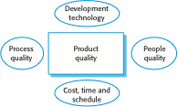
Figure 26.1 Factors affecting software product quality

Slide 3
Figure 26.2 Process attributes
Process characteristic | Key issues
Understandability | To what extent is the process explicitly defined and how easy is it to understand the process definition?
Standardization | To what extent is the process based on a standard generic process? This may be important for some customers who require conformance with a set of defined process standards. To what extent is the same process used in all parts of a company?
Visibility | Do the process activities culminate in clear results, so that the progress of the process is externally visible?
Measurability | Does the process include data collection or other activities that allow process or product characteristics to be measured?
Supportability | To what extent can software tools be used to support the process activities?
Acceptability | Is the defined process acceptable to and usable by the engineers responsible for producing the software product?
Reliability | Is the process designed in such a way that process errors are avoided or trapped before they result in product errors?
Robustness | Can the process continue in spite of unexpected problems?
Maintainability | Can the process evolve to reflect changing organizational requirements or identified process improvements?
Rapidity | How fast can the process of delivering a system from a given specification be completed?

Slide 4
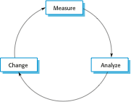
Figure 26.3 The process improvement cycle

Slide 5
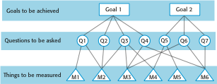
Figure 26.4 The GQM paradigm

Slide 6
Figure 26.5 Aspects of process analysis
Process aspect | Questions
Adoption and standardization | Is the process documented and standardized across the organization? If not, does this mean that any measurements made are specific only to a single process instance? If processes are not standardized, then changes to one process may not be transferable to comparable processes elsewhere in the company.
Software engineering practice | Are there known, good software engineering practices that are not included in the process? Why are they not included? Does the lack of these practices affect product characteristics, such as the number of defects in a delivered software system?
Organizational constraints | What are the organizational constraints that affect the process design and the ways that the process is performed? For example, if the process involves dealing with classified material, there may be activities in the process to check that classified information is not included in any material due to be released to external organizations. Organizational constraints may mean that possible process changes cannot be made.
Communications | How are communications managed in the process? How do communication issues relate to the process measurements that have been made? Communication problems are a major issue in many processes and communication bottlenecks are often the reasons for project delays.
Introspection | Is the process reflective (i.e., do the actors involved in the process explicitly think about and discuss the process and how it might be improved)? Are there mechanisms through which process actors can propose process improvements?
Learning | How do people joining a development team learn about the software processes used? Does the company have process manuals and process training programs?
Tool support | What aspects of the process are and aren’t supported by software tools? For unsupported areas, are there tools that could be deployed cost-effectively to provide support? For supported areas, are the tools effective and efficient? Are better tools available?

Slide 7
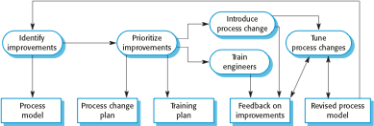
Figure 26.6 The process change process

Slide 8
Figure 26.7 Process areas in the CMMI
Category | Process area | Category | Process area
Process management | Organizational process definition (OPD) | Engineering | Requirements management (REQM)
 | Organizational process focus (OPF) |  | Requirements development (RD)
 | Organizational training (OT) |  | Technical solution (TS)
 | Organizational process performance (OPP) |  | Product integration (PI)
 | Organizational innovation and deployment (OID) |  | Verification (VER)
Project management | Project planning (PP) |  | Validation (VAL)
 | Project monitoring and control (PMC) | Support | Configuration management (CM)
 | Supplier agreement management (SAM) |  | Process and product quality management (PPQA)
 | Integrated project management (IPM) |  | Measurement and analysis (MA)
 | Risk management (RSKM) |  | Decision analysis and resolution (DAR)
 | Quantitative project management (QPM) |  | Causal analysis and resolution (CAR)

Slide 9
Figure 26.8 Examples of goals in the CMMI
Goal | Process area
Corrective actions are managed to closure when the project’s performance or results deviate significantly from the plan. | Project monitoring and control (specific goal)
Actual performance and progress of the project are monitored against the project plan. | Project monitoring and control (specific goal)
The requirements are analyzed and validated, and a definition of the required functionality is developed. | Requirements development (specific goal)
Root causes of defects and other problems are systematically determined. | Causal analysis and resolution (specific goal)
The process is institutionalized as a defined process. | Generic goal

Slide 10
Figure 26.9 Goals and associated practices in the CMMI
Goal | Associated practices
The requirements are analyzed and validated, and a definition of the required functionality is developed. | Analyze derived requirements systematically to ensure that they are necessary and sufficient.
 | Validate requirements to ensure that the resulting product will perform as intended in the user’s environment, using multiple techniques as appropriate.
Root causes of defects and other problems are systematically determined. | Select the critical defects and other problems for analysis.
 | Perform causal analysis of selected defects and other problems and propose actions to address them.
The process is institutionalized as a defined process. | Establish and maintain an organizational policy for planning and performing the requirements development process.

Slide 11
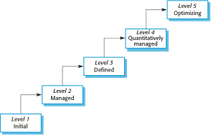
Figure 26.10 The CMMI staged maturity model

Slide 12
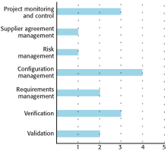
Figure 26.11 A process capability profile

